Slide 1

Basic of Marketing

Slide 2
Choosing a Value Proposition
The set of benefits or values a company promises to deliver to consumers to satisfy their needs.
Value propositions dictate how firms will differentiate and position their brands in the marketplace.

Slide 3
The Marketing Concept
The marketing concept:
A marketing management philosophy that holds that achieving organizational goals depends on knowing the needs and wants of target markets and delivering the desired satisfaction better than competitors.

Slide 4
Customer Perceived Value
Customer perceived value:
“Customer’s evaluation of the difference between all of the benefits and all of the costs of a marketing offer relative to those of competing offers.” (Armstrong & Kotler)
Perceptions may be subjective
Consumers often do not objectively judge values and costs.
Customer value = perceived benefits – perceived sacrifice.
Notes:
Burberry- an example when over-riding social factors impacted on customer perceived value of the Burberry brand- often seen as highly exclusive and expensive brand and instantly recognisable. When it was ‘adopted’ by the football hooligan fraternity, and knock-offs became more common than the original brand, it started to affect perceived value- people don’t want to be associated with a cheapened brand, and began to associate the brand with the undesirable behaviours of the people wearing it.

Slide 5
The Marketing Mix
The set of controllable, tactical marketing tools that the firm blends to produce the response it wants in the target market.
Product: Variety, features, brand name, quality, design, packaging, and services.
Price: List price, discounts, allowances, payment period, and credit terms.
Place: Distribution channels, coverage, logistics, locations, transportation, assortments, and inventory.
Promotion: Advertising, sales promotion, public relations, and personal selling.

Slide 6
Customer-Driven Marketing Strategy
Requires careful customer analysis.
To be successful, firms must engage in:
Market segmentation
Market targeting
Differentiation
Positioning

Slide 7
Market Segmentation and Targeting
Segmentation:
The process of dividing a market into distinct groups of buyers with different needs, characteristics, or behavior who might require separate products of marketing programs.
Targeting:
Involves evaluating each market segment’s attractiveness and selecting one or more segments to enter.

Slide 8
Differentiation and Positioning
Differentiation:
Creating superior customer value by actually differentiating the market offering.
Positioning:
Arranging for a product to occupy a clear, distinctive, and desirable place relative to competing products in the minds of target consumers.

Slide 9

Market Segmentation
Key segmenting variables:
Geographic
Demographic
Psychographic
Behavioral
Different segments desire different benefits from products.
Best to use multivariable segmentation bases in order to identify smaller, better-defined target groups.
Notes:
No single way to segment is best. Often combine more than one variable to better define segments.
Geographic- simply where people live
Demographic- the easiest and most popular segmenting variable.
Psychographic segmentation:
Dividing a market into different groups based on social class, lifestyle, or personality characteristics.
Behavioral segmentation:
Dividing buyers into groups based on consumer knowledge, attitudes, uses, or responses to a product.
MTV- different ages favour different channels. MTV pay attention to geographical differences also.

Slide 10
Consider the market for Lamborghinis, an automobile costing more than $150,000.
The market would be very small in countries with 2 types of income patterns-
(1) very low incomes; or
(2) mostly low incomes;
One of the largest single markets for Lamborghinis turns out to be Portugal [income pattern very low, very high incomes
Portugal is one of the poorer countries in Western Europe, but one with enough wealthy families to afford expensive cars.

Slide 11
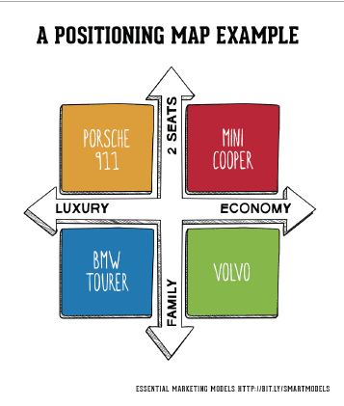

Slide 12
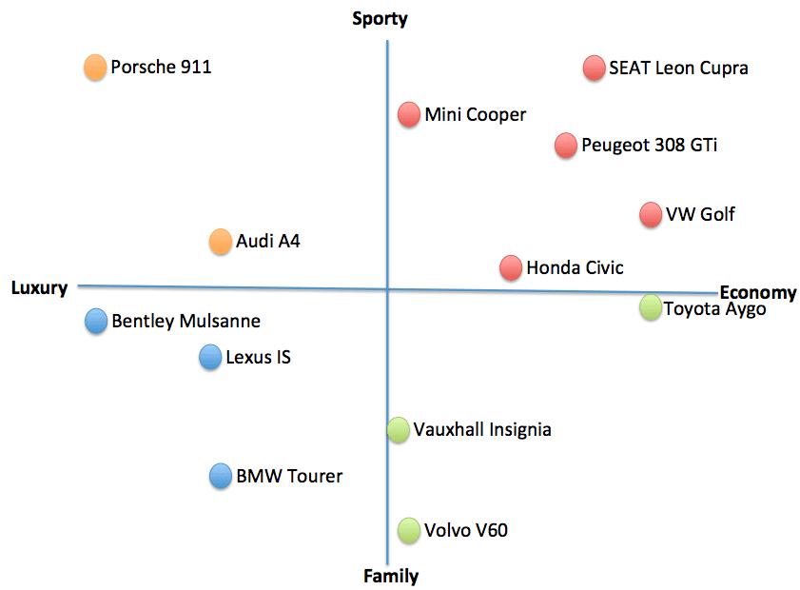

Slide 13
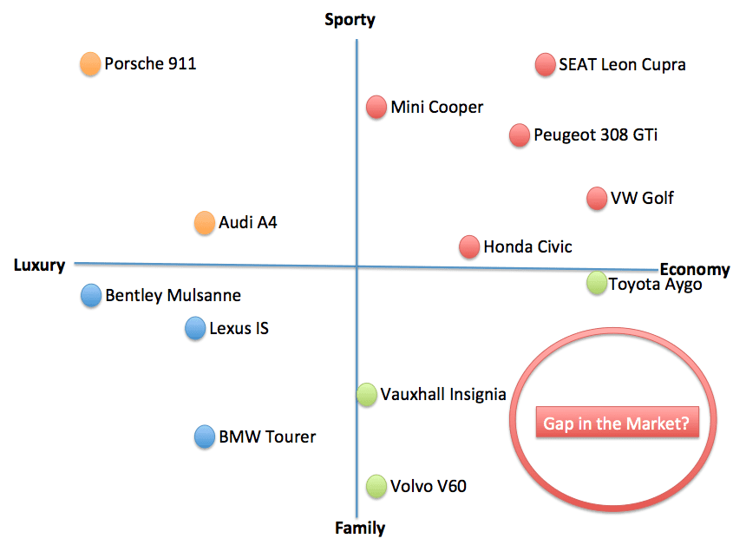

Slide 14
Examples of STP marketing
Cola wars
The cola wars between Coca-Cola and Pepsi in the 1980s are a great example of STP marketing. These companies were fighting to become the most popular soft drink, so they had to position themselves correctly when it came to targeting.
Coca-Cola replaced their Coke with a “new” Coke.
Pepsi continued with sustained marketing and positioned itself as a “new generation soft drink”. They also targeted loyal Coke drinkers after Coke introduced the “new” Coke. They did this by positioning themselves as the reason why Coke introduced the “new” Coke. They were able to attract the Coke loyalists who preferred the “old” Coke.
Pepsi invested in advertising via different channels. They also did a lot of guerilla marketing that involved using different tactics to lure their target audience into drinking Pepsi instead of Coke.

Slide 15
4- Virgin Holidays
Virgin Holidays is another good example of the successful use of STP marketing. The company created six different segments of its customers. They used segmentation, positioning, and targeting to promote holidays.
5- Nike
Nike uses STP marketing to reach a wide variety of customers. The company positions itself as a sports product and offers different products for different people, such as Air Force 1 shoes, Nike running shoes, or Nike+ training programs.
6- McDonald’s
McDonald’s uses targeting by offering different menu items for different demographics. A teenager or a student would go to McDonald’s for a burger, while people who work their morning shifts might go for breakfast meals.
The more you know about what they’re looking for and what problems they have, the easier it will be to build a relationship with them and get them to buy from you.
You need to invest in new digital channels such as social media and content marketing for STP marketing to work.

Slide 16
This makes it easier for customers to choose what they want and makes them feel more satisfied with their meal. This way, the company can attract a wider audience that will most likely return as customers.
These are just three examples of STP marketing. Plenty of other successful companies have used this marketing strategy to attract new loyal customers. As you can see, this is a very effective marketing strategy that you should consider when planning your next campaign.
How to make STP Marketing work for you?
The STP marketing approach requires you to make different decisions about finding your target group, especially now that there are so many options available for companies that want to expand their brand awareness.
STP works great in today’s digital age because it helps you become an authority in your niche without spending too. To make STP Marketing work for you, you will need to do the following:
You’ll have to consider what strategies work best for your target audience and adjust your strategy accordingly.
You’ll also have to start focusing on building a relationship with your customer and finding out more about their needs. Only then will you be able to offer them products that your target audience wants.
You need to know who you’re catering to and what kind of product they’re looking for.

Slide 17
2- iPhone
Apple is another brand that uses STP marketing by giving the best user experience out there. The iPhone was launched in 2007, and people loved it. It came with a brand new design, and people were looking for the new Apple product.
Apple did heavy markets its product by positioning itself as an innovative product. Everyone wanted to get their hands on the iPhone and learn more about its features.
Today, Apple is one of the biggest companies globally, and this is thanks to constant innovation and a strong brand.
3- BT Plc
British Telecom is another great example of STP marketing. The company adopted STP model to cater to its various customer groups.
They target individual customers and other customers with different offerings. BT has developed lots of products and services that suit different customers. This way, they’re able to reach an audience that’s much larger than their original one.
They also position themselves as a forward-thinking company that offers the best technology, attracting more customers.

Slide 18
STP Marketing: An Example
Marriott International® owns a number of different hotel chains that target specific consumer groups.
Luxury – targets the luxury consumer. These facilities provide luxury experiences and include iconic brands such as The Ritz-Carlton, St Regis, JW Marriott, and W Hotels.
Premium – targets younger couples and business consumers. Premium brands offer sophisticated, chic hotels, and include classic brands such as Marriott Hotels and Sheraton, as well as more distinctive brands like Le MERIDIEN and Westin.
Select – targets seasoned travelers, and provides smart and modern amenities.
Longer Stays – targets families with children. These amenities are designed for longer vacations that mirror the comforts of home, and include brands such as Marriott Executive Apartments, TownePlace Suites, element, and Homes & Villas by Marriott International.
Collection – targets very high-end, luxury consumers looking for a special and unique experience.
As you can imagine, Marriott International doesn't communicate the same marketing message to all of its customers. Each hotel is designed and positioned to appeal to the unique wants and needs of a specific group.

Slide 19
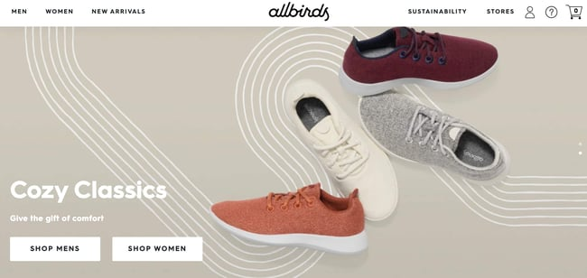
AllBirds
AllBirds didn’t let that stop it from carving out a new niche in a busy space full of comfortable, active shoe options.
How did AllBirds position itself to set itself apart from the competition? By elevating its eco-consciousness and placing that front and center in its marketing. According to the AllBirds website, the brand “crafts with planet-friendly natural materials, like merino wool and eucalyptus trees,
At first glance, AllBirds shoes don’t look too terribly different from other running or walking shoes. However, its audience segment that cares about sustainability and earth-conscious products knows the difference.

Slide 20

Market Segmentation
Why Segment?:
Meet consumer needs more precisely
Increase profits
Segment leadership
Retain customers
Focus marketing
communications

Slide 21
Evaluating Market Segments
Segment size and growth:
Analyze current segment sales, growth rates, and expected profitability.
Segment structural attractiveness:
Consider competition, existence of substitute products, and the power of buyers and suppliers.
Company objectives and resources:
Examine company skills and resources needed to succeed in that segment.
Offer superior value and gain advantages over competitors.

Slide 22
Market Targeting
Market targeting involves:
Evaluating marketing segments.
Segment size, segment structural attractiveness, and company objectives and resources are considered.
Selecting target market segments.
Alternatives range from undifferentiated marketing to micromarketing.
Being socially responsible.

Slide 23
Differentiation and Positioning
A product’s position is:
The way the product is defined by consumers on important attributes—the place the product occupies in consumers’ minds relative to competing products.
Perceptual positioning maps can help define a brand’s position relative to competitors.

Slide 24
Differentiation and Positioning
Identifying possible value differences and competitive advantages:
Key to winning target customers is to understand their needs better than competitors do and to deliver more value.
Competitive advantage:
Extent to which a company can position itself as providing superior value.
Achieved via differentiation.

Slide 25

Positioning
Press ads of the Scorpio focused on the functional features of the vehicle and the television ads focused on emotional benefits.

Slide 26
Think about the concept of the mental product grid and all the products that have established brand positions in your mind.
Simple examples are to be found in the cars we buy. Certain customers believe that Mercedes Benz has “the best engineered cars in the world”. Others with the same socio-economic profile believe that BMW provides the “ultimate driving experience”. And, yet others will tell you that Volvo’s are the “safest cars on the road”.
Obviously, Toyota has also done a great job of marketing with their Camry, Avalon and Lexus brands as many more car customers these days are seeking them out over GM and Ford products.

Slide 27

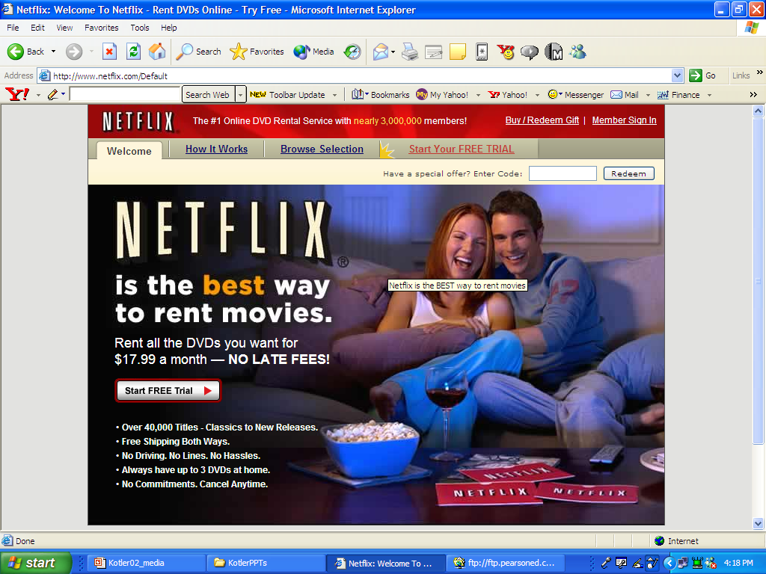
Netflix’s Distinctive Capabilities

